Slide 1
Samba KCC: Saying No to Full Mesh Replication
Garming Sam Catalyst IT, Samba Team
Notes:
1
1

Slide 2
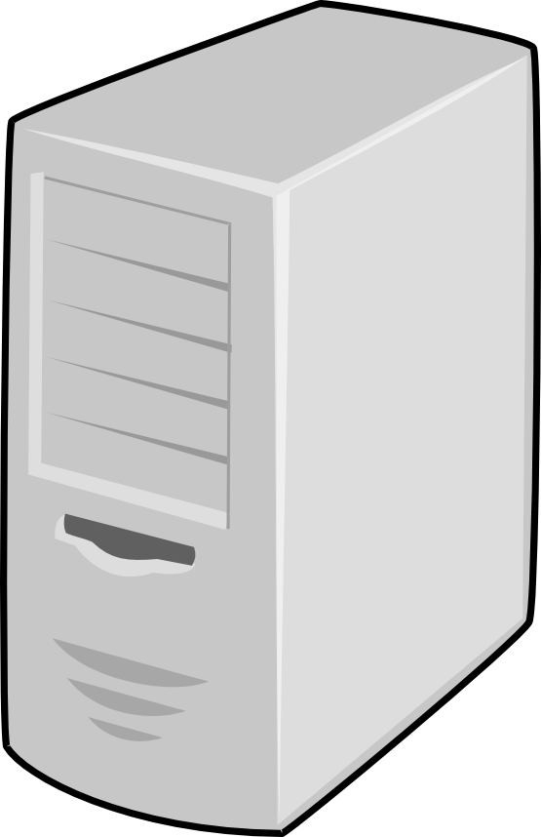
What is the KCC?
Knowledge consistency checker
Used to manage replication connections in AD
Set of algorithms to produce efficient network topologies
Site B
Site D
Site A
Site C
Notes:
2
2

Slide 3
What is the KCC?
Notes:
3
3

Slide 4
What is the KCC?
Notes:
4
4

Slide 5
What is the KCC?
Notes:
5
5

Slide 6
What is the KCC?
Notes:
6
6

Slide 7
History of the KCC
Original full-mesh C code
Attempt at MS-ADTS algorithms in C
Dave Craft (2011) on Python inter-site algorithms
Late 2014—Early 2015 Douglas and myself
Samba 4.3 introduced, Samba 4.5 set as default
Notes:
7
7

Slide 8
Stages of the algorithm
Intra-site algorithm
Inter-site algorithm
Removing unneeded connections
Translate connections
Although the KCC creates ‘connection’ objects, they may not represent the underlying replication. They are only the implied connections given the current network topology.
Notes:
8
8

Slide 9
Pre-requisites
Transport – IP
dn: CN=IP,CN=Inter-Site Transports,CN=Sites,CN=Configuration,DC=example,DC=com
objectClass: interSiteTransport
Sites – Default-First-Site
dn: CN=Default-First-Site-Name,CN=Sites,CN=Configuration,DC=example,DC=com
objectClass: site
dn: CN=NTDS Site Settings,CN=Default-First-Site-Name,CN=Sites,CN=Configuration,DC=example,DC=com
objectClass: nTDSSiteSettings
interSiteTopologyGenerator: CN=NTDS Settings,CN=DC,CN=Servers,CN=Default-First-Site-Name,CN=Sites,CN=Configuration,DC=example,DC=com
Notes:
9
9

Slide 10
Pre-requisites
Site-Links – DEFAULTIPSITELINK
dn: CN=DEFAULTIPSITELINK,CN=IP,CN=Inter-Site Transports,CN=Sites,CN=Configuration,DC=example,DC=com
objectClass: siteLink
cost: 100
siteList: CN=Default-First-Site-Name,CN=Sites,CN=Configuration,DC=example,DC=com
Site-links define the allowable connections between sites
Site-links represent (hub-like) physical connectivity
Site-links needs to collectively span your entire network
Notes:
10
10

Slide 11
Pre-requisites - Scenarios
SITELINKA
Site-1
Site-2
Default-First-Site
Site-3
DEFAULTIPSITELINK
SITELINKB
Notes:
11
11

Slide 12
Intra-site algorithm
Creates connections within a single site
With just a single server, no work is necessary
Ring topology, with a few extra connections (n > 7)
Notes:
12
12

Slide 13
Intra-site algorithm
Ring topology, with a few extra connections
Notes:
13
13

Slide 14
Intra-site algorithm
Every DC in the site has a sorted list of site DCs
Notes:
14
14

Slide 15
Intra-site algorithm
Compared to the old KCC, there are fewer connections
The algorithm is quite reliable, adding additional connections
Information propagates in a more controlled manner
In a single-site use-case, with not that many DCs, behaviour should be quite similar to the old code.
Notes:
15
15

Slide 16
Inter-site algorithm
Each site elects an inter-site topology generator (ISTG)
Re-election attempts to occur if the ISTG is not responding
Attribute: interSiteTopologyFailover
Site B
Site D
Site A
Site C
Notes:
16
16

Slide 17
Inter-site algorithm
Stable answer across entire DC network
One DC per site managing inter-site connections
Needs to be as fault tolerant as possible
Must produce topology optimizing cost and schedules
Notes:
17
17

Slide 18
Inter-site algorithm
Site B
Site A
Site C
Site D
Bridgehead servers are the end-point connections between sites.
Notes:
18
18

Slide 19
Inter-site algorithm
Site B
Site A
Site C
Site D
Being a bridgehead does not imply being an ISTG.
Notes:
19
19

Slide 20
Inter-site algorithm
Site B
Site A
Site C
Site D
There is not necessarily a single bridgehead server.
Notes:
20
20

Slide 21
Inter-site algorithm
DC1
DC2
pulls from
There is only pull replication. Bi-directional replication must be done with two distinct connections.
Notes:
21
21

Slide 22
Inter-site algorithm
Site B
Site A
Site C
Site D
The inter-site algorithm only runs on the ISTG.
Notes:
22
22

Slide 23
Inter-site algorithm
Site B
Site A
Site C
Site D
Assume the ISTG in Site D is running for the first time.
Notes:
23
23

Slide 24
Inter-site algorithm
Site B
Site A
Site C
Site D
A new connection will be created in the database pointing to a randomly chosen bridgehead in Site A. Intra-site replication will propagate this to the necessary bridgehead in Site D.
Notes:
24
24

Slide 25
Inter-site algorithm
Site B
Site A
Site C
Site D
The incoming bridgehead runs the KCC and notices the new connection (and translates it). It has no idea why it connects to the DC, that’s the role of the ISTG.
Notes:
25
25

Slide 26
Inter-site algorithm
Site B
Site A
Site D
Site C
Notes:
26
26

Slide 27
Inter-site algorithm
Site B
Site A
Site D
Site C
Notes:
27
27

Slide 28

Inter-site algorithm
Site B
Site A
150
100
500
Site D
200
Site C
Notes:
28
28

Slide 29
Inter-site algorithm
Site B
Site A
150
100
500
Site D
200
Site C
Notes:
29
29

Slide 30
Inter-site algorithm
Site B
Site A
150
100
500
Site D
200
Site C
Notes:
30
30

Slide 31
Inter-site algorithm
Site B
Site A
150
100
500
Site D
200
Site C
Total cost: 450
Notes:
31
31

Slide 32
Inter-site algorithm - Failover
Site B
Site A
150
100
500
Site D
200
Site C
Notes:
32
32

Slide 33
Inter-site algorithm - Failover
Site B
Site A
150
100
500
Site D
200
Site C
On network connectivity failure, the KCC attempts to overlay a second redundant topology.
Notes:
33
33

Slide 34
Remove unneeded connections
Removes connections:
which are duplicated (removing the oldest)
which exceed redundancy limit (intra-site)
Area still needs some work, however, removing too aggressively may cause connectivity issues.
Notes:
34
34

Slide 35
Translate connections
Of the connections the KCC deems necessary, they are translated into repsFrom (non-replicated attributes)
NTDS-Connection
repsFrom
Notes:
35
35

Slide 36
Two independent tasks running
KCC running periodically
Creating NTDS Connection objects (ISTG or intra-site)
Translating NTDS Connections to repsFrom
DREPL server
Reading repsFrom and pulling from the target
Reading repsTo and telling target to pull
This means it can take some time to propagate, particularly repsTo which are deferred created by replication on repsFrom.
Notes:
36
36

Slide 37
Translate connections
Of the connections the KCC deems necessary, they are translated into repsFrom (non-replicated attributes)
repsFrom flags are set (particularly important for RODC)
Stale repsFrom SHOULD be deleted
Stale repsTo SHOULD be deleted
Notes:
37
37

Slide 38
The end result
Single path from any site to any site (property of a tree)
Changes should not bounce around significantly
Significantly reduced replication traffic
Ability to customize who should talk to who
Small networks (n <= 4) should have no visible effect
Larger networks with varying connectivity shows huge effect
Notes:
38
38

Slide 39
Challenges
Verbose documentation
Site-Link: ‘Multi-edge’, hyper-edge?
White, red, black vertices?
Notes:
39
39

Slide 40
More challenges
Logical inconsistencies, ambiguities and omissions
Pseudo-code vs textual description
Easy to debug your own bugs
Testing?
--dot-file-dir
--readonly --exportldif, --importldif
Notes:
40
40

Slide 41
Incomplete features
Trusted domains and global catalog replication
RODC self-management
Site-Link-Bridge Topologies
Respecting schedules and other AD attributes
Preferred bridgehead servers
Replication frequency?
Notes:
41
41

Slide 42
Incomplete features
Failed connection and failed DC failover
Better stale connection clean-up
MS-DS-Replicates-NC-Reason
Use normal replication to propagate failure info
Better debugging and failure information
Better defaults for modern networks
Notes:
42
42

Slide 43
Alternative topology strategies
What is the best topology for various networks?
Ring algorithm from intra-site for inter-site
Minimum cost spanning tree plus additional connections
Fully connected bridge-head servers
Notes:
43
43

Slide 44
Alternative topology strategies
What is the best topology for various networks?
Ring algorithm from intra-site for inter-site
Minimum cost spanning tree plus additional connections
Fully connected bridge-head servers
Notes:
44
44

Slide 45
Questions?
Email: garming@catalyst.net.nz
Notes:
45
45

